Slide 1
Foundations of Data Science & Analytics (DSCI 633)
Nidhi Rastogi
Assistant Professor, GCCIS
Rochester Institute of Technology
August 24, 2021

Slide 2
RIT Data Science Program
Bridge the gap between research and application
The gap is closing thanks to rapidly developed softwares
Provide talents with expertise both in data science and software development
Google: we do not hire software engineers who know nothing about machine learning, nor do we hire researchers who cannot code.

Slide 3


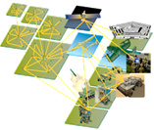

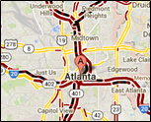



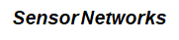
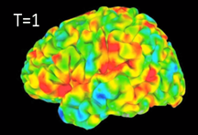
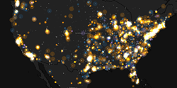
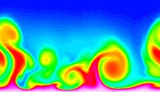
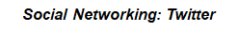
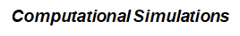
Data Mining is Everywhere
Brain Activity

Slide 4

Behind the Trend (Why?)
Lots of data is being collected and warehoused
Yahoo has Peta Bytes of web data
Facebook has billions of active users
Amazon handles millions of visits/day
Computers have become cheaper and more powerful

Slide 5
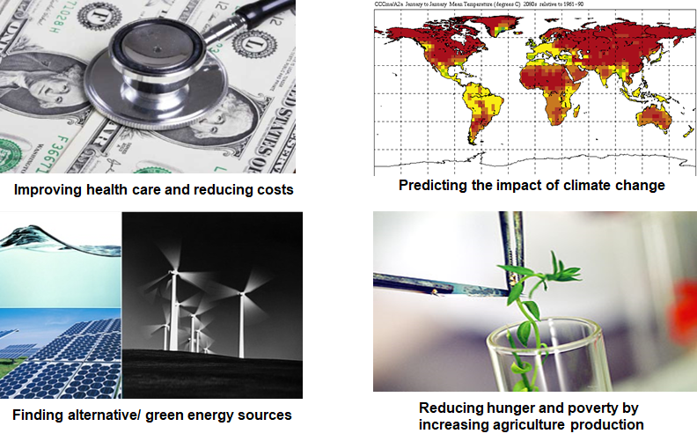

Great Opportunity
Optimizing the development of software

Slide 6
What is NOT Data Mining?
Look up phone number in phone directory
Query a Web search engine for information about “Amazon”
What is Data Mining?
Certain names are more prevalent in certain US locations (O’Brien, O’Rourke, O’Reilly… in Boston area)
Predict whether user want information on Amazon rainforest or Amazon.com when searching for “Amazon”

Slide 7
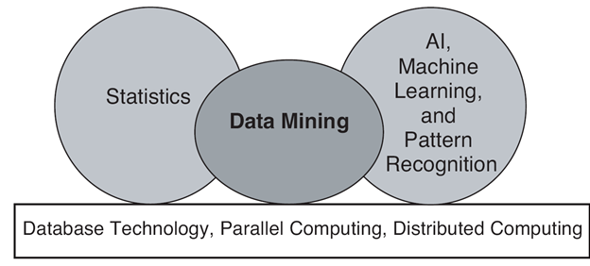
Origin of Data Mining
Especially for data:
Large-scale
High dimensional
Complex
Distributed

Slide 8
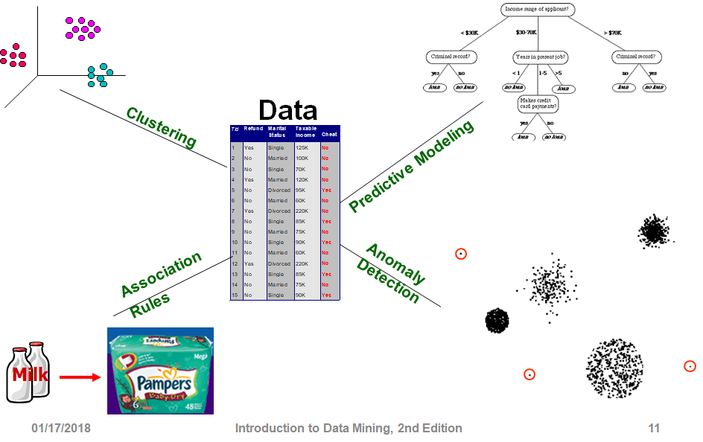
Tasks

Slide 9
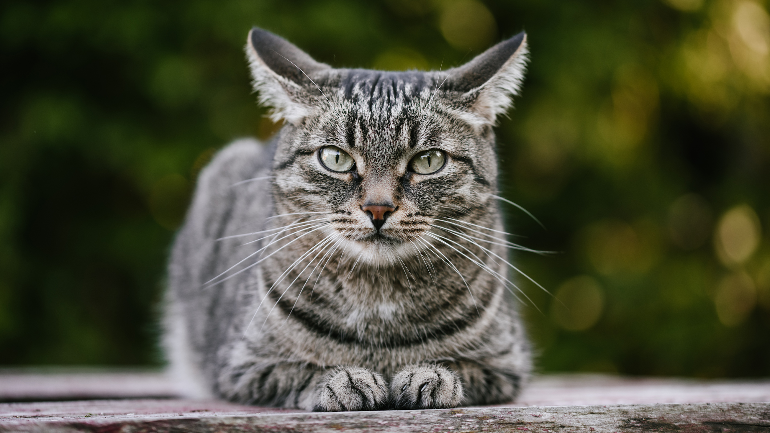
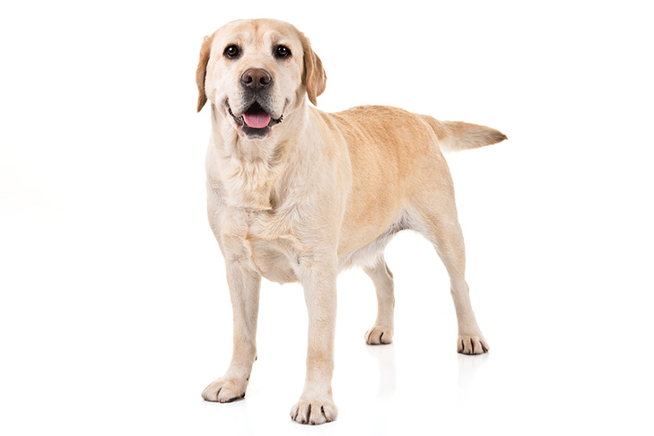

Predictive Modeling (supervised learning)
Independent Variable (Input)
Dependent Variable (Output)
Cat
Train:
Dog
Predict:
?

Slide 10
Predictive Modeling
Output
Classification:
Regression:
Classes / Categories
Continuous Numbers

Slide 11
Predictive Modeling: Classification
Image Classification
Cat
Dog
Bird
Pig
Lion
...

Slide 12
Predictive Modeling: Classification
Sentiment Analysis (NLP)
You have been working on this for months.
I need to see your results, now!
Positive
Neutral
Negative

Slide 13
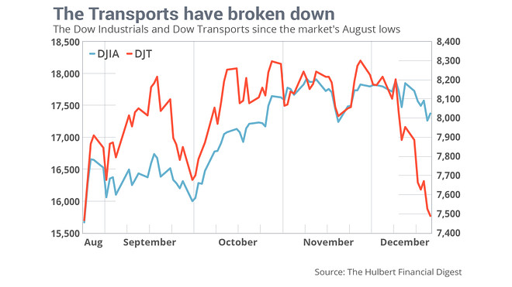
Predictive Modeling: Regression
Time Series Analysis
DJIA and DJT for January?

Slide 14
Predictive Modeling: Regression
ID | Name | Gender | GRE | Coding
001 | Emily Wang | F | 320 | Yes
002 | James Bond | M | 320 | Yes
Problem?
Bias
Score in Foundation of Data Science

Slide 15
Tasks

Slide 16
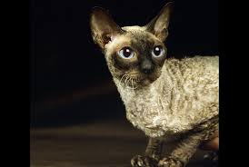

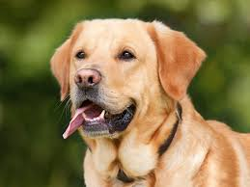
Clustering (unsupervised learning)
Independent Variable

Slide 17
Clustering (unsupervised learning)
Independent Variable

Slide 18
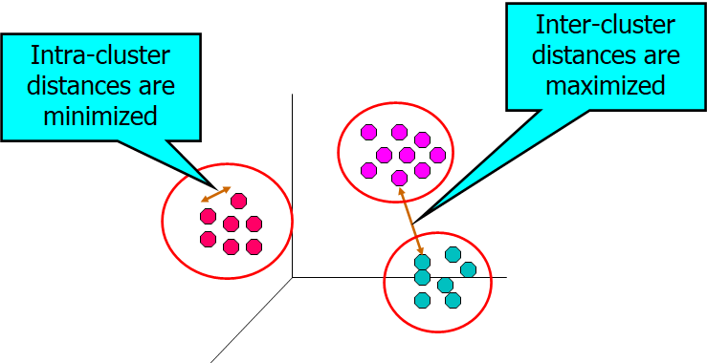
Clustering (objectives)

Slide 19
Clustering (applications)
User ID | Titanic | Die Hard | Avatar
001 | Yes | Yes | No
002 | Yes | No | Yes
Groups of users that like similar movies

Slide 20
Clustering (applications)
Topic Modeling
Area soccer players earn all-state selections.
Sports | Politics | News | Movie
0.4 | 0.18 | 0.4 | 0.02

Slide 21
Tasks

Slide 22
Association Rule Learning
User ID | Titanic | Die Hard | Avatar
001 | Yes | Yes | Yes
002 | Yes | No | Yes
People who watched Titanic will also watch Avatar

Slide 23
Tasks

Slide 24
Anomaly Detection
Purchase | 11/03/2019 | 11/13/2019 | 11/23/2019 | 12/03/2019 | 12/04/2019
001 | Titanic | Avatar | Die Hard | Aliens | Hunter X Hunter

Slide 25
Tasks
Credit card fraud detection
Co-fail test cases
Weather forecast
Community detection on social networks

Slide 26
Preparation for Assignment and Project
Create GitHub account
Fork : https://github.com/aiforsec/RIT-DSCI-633-FDS
Add your GitHub username in this spreadsheet
4. Add Instructor (aiforsec) and Tas (TBD) as collaborators to your forked repository.
Steps to add a collaborator - link

Slide 27
Questions

